Slide 1

SOFTWARE REQUIREMENT SPECIFICATION FOR CHAT APPLICATION

Slide 2
SOFTWARE REQUIREMENT SPECIFICATION FOR CHAT APPLICATION
LMS USER NAME | NAME | BATCH
dharini_A9 | Dharini Sriya Ramineedi | A9
kaveri_A9 | Kaveri C | A9
keerthana_A9 | Keerthana R | A9
lakshi_A9 | Lakshi K | A9

Slide 3
INTRODUCTION
Chatbots are computer programmes that can carry on a conversation with a user in simple language, discern their purpose, and respond in accordance with predefined rules and data. In order to accurately mimic how a human would behave in a discussion, chatbot systems often need constant testing and adjustment, with many currently in use being unable to fully converse
The primary focus of this project was the creation of a messaging protocol that would enable the program to correctly log in users, transmit messages, and carry out system maintenance

Slide 4
INNOVATIVE IDEAS OF PROJECTS
GUI:
The program is simple to use, so even those with very rudimentary computer operating experience may utilize it.
PLATFORM INDEPENDENCE:
No matter what system's base operating system is, the messenger can run on it.
UNLIMITED CLIENTS:
Without the server's performance suffering, an infinite number of users can join.

Slide 5
PROJECT OBJECTIVES
COMMUNICATION
To create an instant messaging system that would allow users to connect with one another without any interruptions
USER FRIENDLINESS
A beginner user should be able to utilize the project with no problem.

Slide 6
PROJECT PERSPECTIVE
NO NEED OF INTERNET
CONNECTION
The suggested system simply needs an Internet connection, as opposed to the existing system's requirement for an Internet connection and a LAN connection. Those who can afford an Internet connection will find this method handy. for instance, colleges, schools, etc.
CONFERENCE POSSIBLE
ON LAN
Frequently, conferencing is not available over LAN connections. The suggested solution enables LAN users to organize and take part in conferences. This enables simultaneous communication between a large number of LAN users.

Slide 7
CONSTRAINTS
The web browser is not automatically opened by the program.
The user must externally open the web browser in order to utilize it.
The device must be permanently connected to the internet.
PRODUCT FUNCTIONS
Different clients and the server can communicate back and forth.
Group discussions may be held using this chat program.
It enables users to locate other logged-in users.

Slide 8
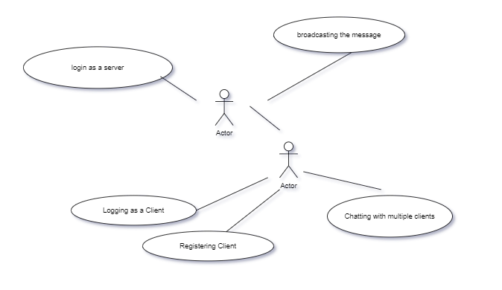
USE CASE DIAGRAM
This use case model shows how client interacts with the server and start getting communicating with other clients

Slide 9
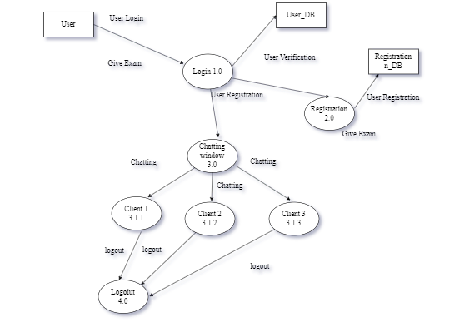
DATA FLOW DIAGRAM

Slide 10
BENIFITS OF CHATBOT
Multiple use cases
Automated Lead Generation
Cost Savings
Scalability
Instant Response
Personalized Interaction

Slide 11
EVOLUTION OF CHATBOT IN FUTURE
A easy, quick, and accessible method of automating client contact and interaction is through chatbots.
Instead of utilizing standard websites, chatbots communicate with people via voice or text and employ natural language.
In the context of user experience, it has developed into an intriguing tool.
Today's chatbots are more adept at comprehending human language because to the continuous infusion of training data.

Slide 12
Submission Github
https://github.com/Lakshi-20/SOFTWARE-REQUIREMENT-SPECIFICATION-FOR-CHAT-APPLICATION.git

Slide 13
THANK YOU !

